Slide 1
Lecture 12
Exponential Distribution

Slide 2
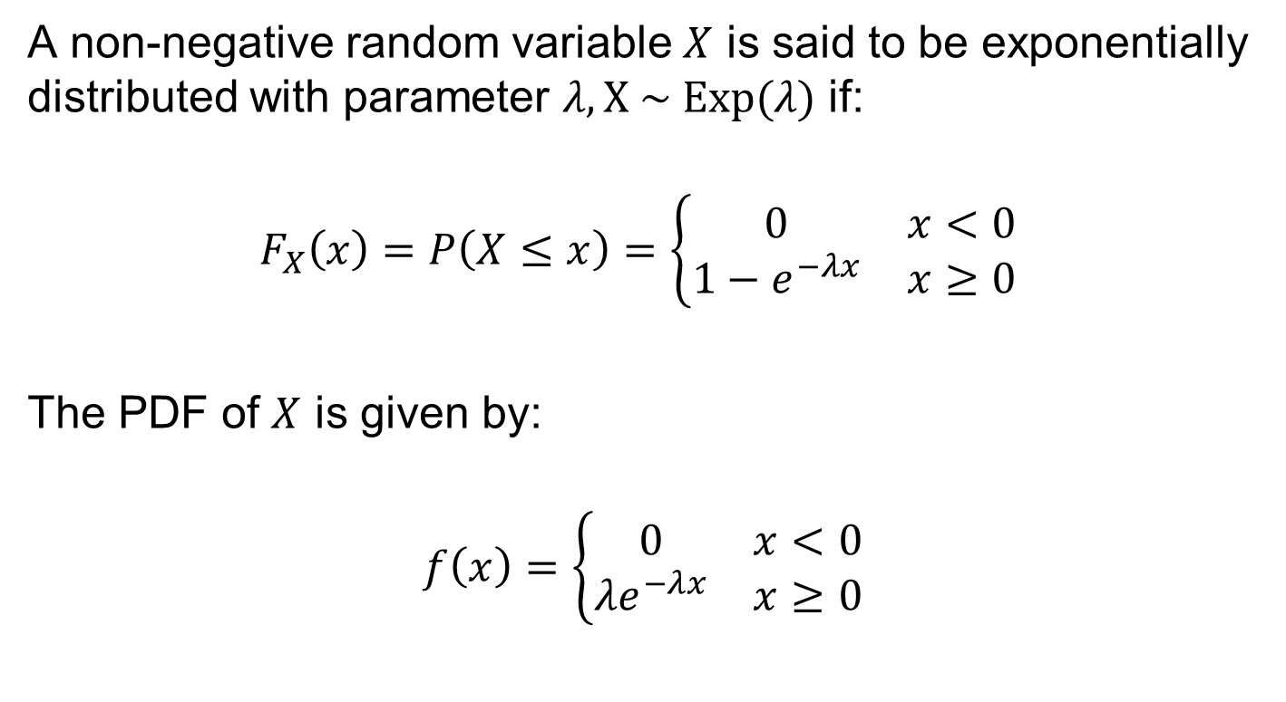
Exponential Distribution
A non-negative random variable $X$ is said to be exponentially distributed with parameter $λ, X \sim Exp(λ)$ if:
$$F_{X}\left(x\right)=P\left(X≤x\right)=\left\{\begin{matrix}0 & x<0 \\ 1−e^{−λx} & x≥0\end{matrix}\right.$$
The PDF of $X$ is given by:
$$f\left(x\right)=\left\{\begin{matrix}0 & x<0 \\ {λe}^{−λx} & x≥0\end{matrix}\right.$$

Slide 3

Exponential Distribution: Memoryless
$X \sim Exp(λ)$ has memoryless property i.e.
$$P\left(X>t+s | X>s\right)=P\left(X>t\right), s,t≥0$$
$$P\left(X>t+s | X>s\right)$$
$$= \frac{P(X>t+s,X>s) }{P(X>s) }$$
$$= \frac{1−P(X≤t+s) }{1−P(X≤s) }$$
$$= \frac{e^{−λ(t+s)} }{ e^{−λs}}$$
$$= P\left(X>t\right)$$

Slide 4
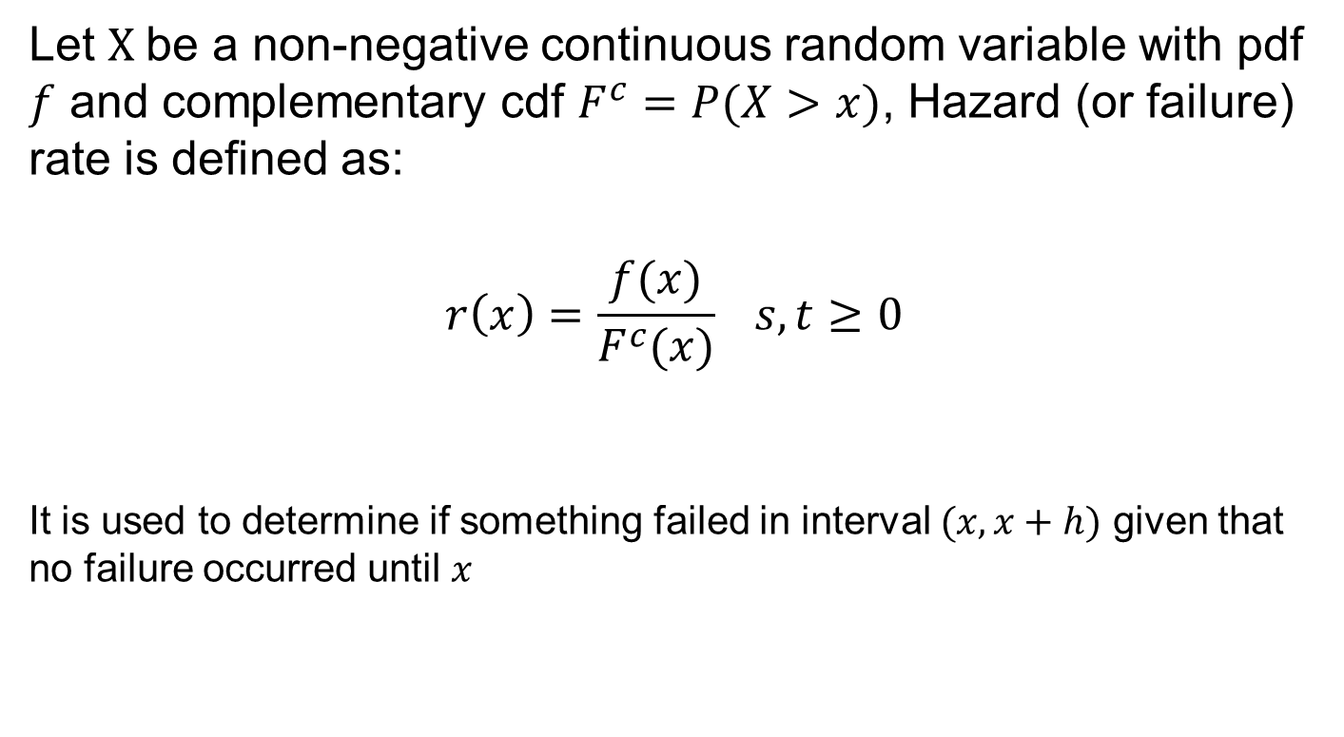
Hazard Rate
Let $X$be a non-negative continuous random variable with pdf $f$ and complementary cdf $F^{c}=P(X>x)$, Hazard (or failure) rate is defined as:
$$r\left(x\right)=\frac{f(x)}{F^{c}(x)} s,t≥0$$
It is used to determine if something failed in interval $(x,x+h)$ given that no failure occurred until $x$

Slide 5
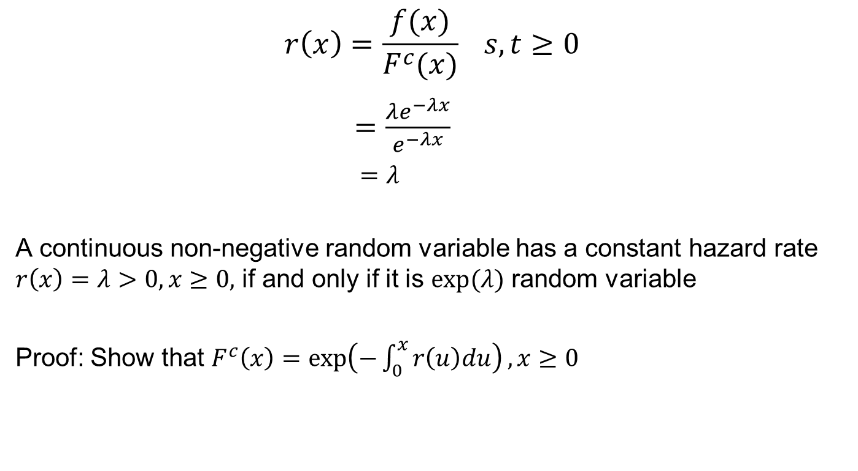
Hazard Rate of Exponential Dist.
$$r\left(x\right)=\frac{f(x)}{F^{c}(x)} s,t≥0$$
$=\frac{λe^{−λx}}{e^{−λx}}$
$=λ$
A continuous non-negative random variable has a constant hazard rate $r\left(x\right)=λ>0, x≥0,$ if and only if it is $exp⁡(λ)$ random variable
Proof: Show that $F^{c}\left(x\right)=\exp\left(−\int_{0}^{x}{r\left(u\right)du}\right), x≥0$

Slide 6
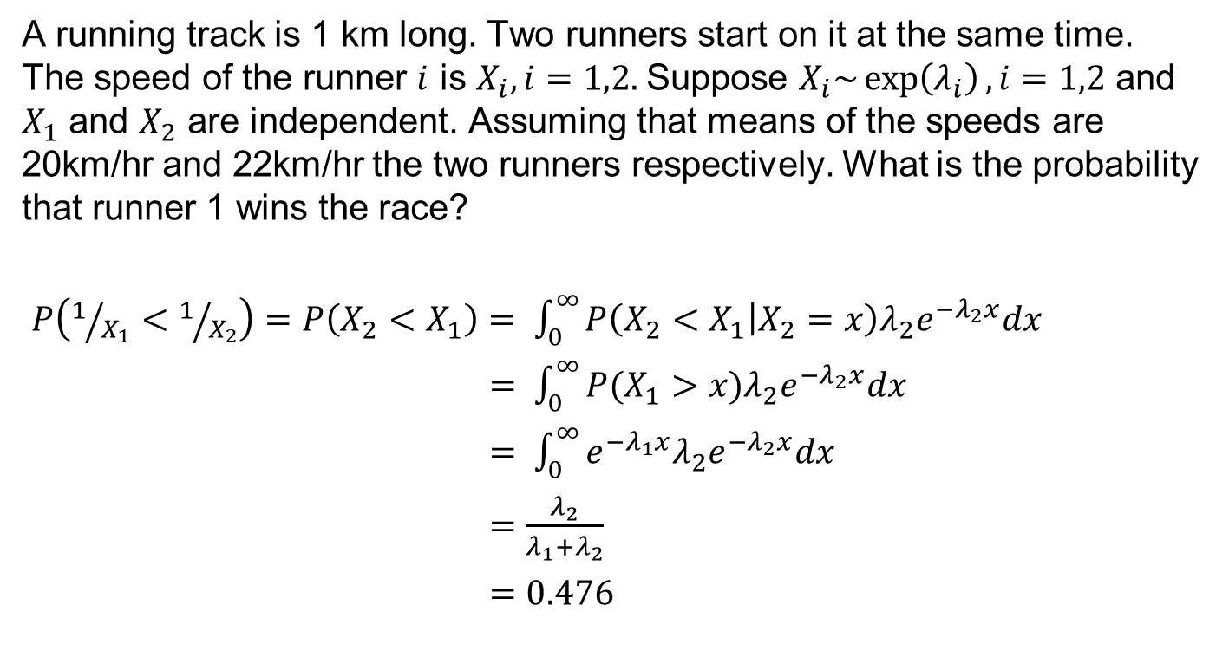
Example
A running track is 1 km long. Two runners start on it at the same time. The speed of the runner $i$ is $X_{i},i=1,2.$Suppose $X_{i}\sim \exp\left(λ_{i}\right),i=1,2$ and $X_{1}$ and $X_{2}$ are independent. Assuming that means of the speeds are 20km/hr and 22km/hr the two runners respectively. What is the probability that runner 1 wins the race?
$P\left(1/{X_{1}}<1/{X_{2}}\right)=P\left(X_{2}<X_{1}\right)= \int_{0}^{∞}{P\left(X_{2}<X_{1} | X_{2}=x\right)λ_{2}e^{−λ_{2}x}dx}$
$= \int_{0}^{∞}{P(X_{1}>x)λ_{2}e^{−λ_{2}x}dx}$
$= \int_{0}^{∞}{e^{{−λ}_{1}x}{λ_{2}e}^{−λ_{2}x}dx}$
$=\frac{λ_{2}}{λ_{1}+λ_{2}}$
$=0.476$

Slide 7
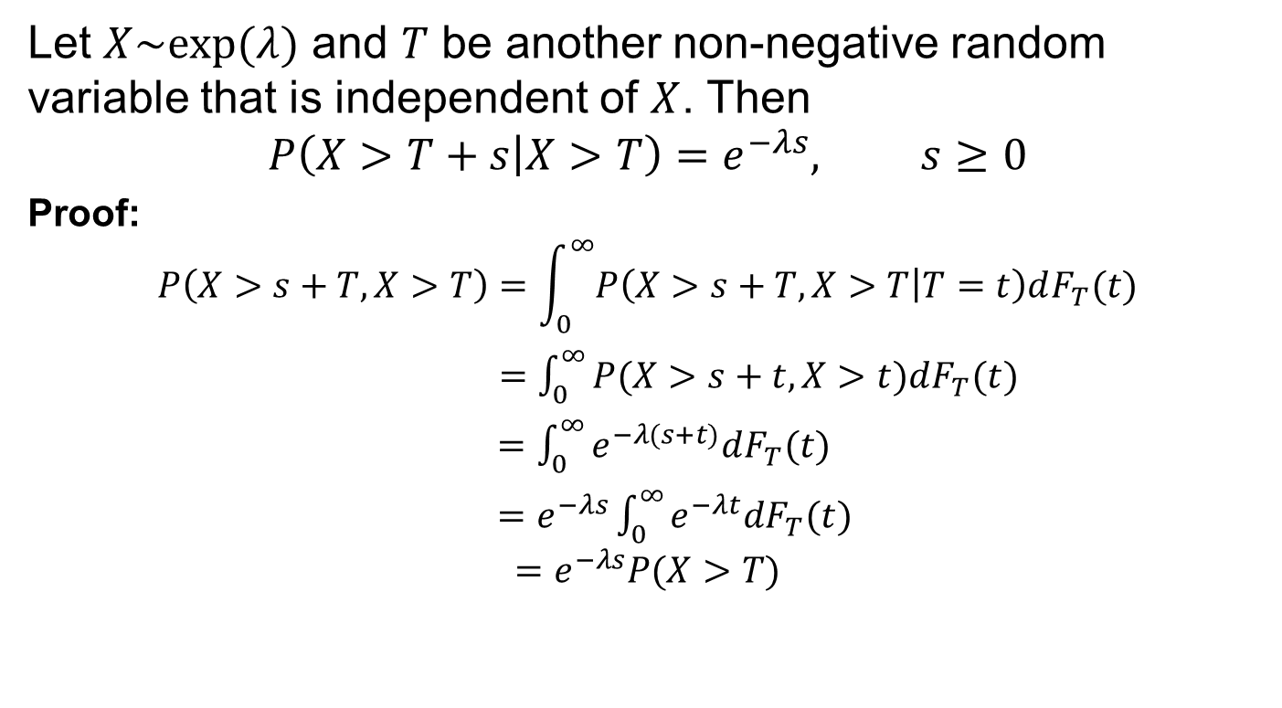
Strong Memory Property
Let $X\sim exp⁡(λ)$ and $T$ be another non-negative random variable that is independent of $X$. Then
$$P\left(X>T+s | X>T\right)=e^{−λs}, s≥0$$
Proof:
$$P\left(X>s+T, X>T\right)=\int_{0}^{∞}{P\left(X>s+T,X>T | T=t\right)dF_{T}(t)}$$
$=\int_{0}^{∞}{P(X>s+t,X>t)dF_{T}(t)}$
$=\int_{0}^{∞}{e^{−λ(s+t)}dF_{T}(t)}$
$=e^{−λs}\int_{0}^{∞}{e^{−λt}dF_{T}(t)}$
$$=e^{−λs}P(X>T)$$

Slide 8
Erlang Distribution

